Slide 1

Global Challenges and Data-Driven Science: An approach for raising awareness about Indicators for the Sustainable Development Goals
Franz-Josef Behr & Muhammad Yahya
Stuttgart University of Applied Sciences
ICA Commission on Standards and Spatial Data Infrastructrures
International CODATA 2017 Conference “Global Challenges and Data-Driven Science”
Sankt Petersburg, 2017-10-11
Content is licensed under Creative Commons-License CC BY-NC-SA

Slide 2
Outline
Motivation
Some definitions regarding "Open"
Some approaches
Getting indicator values
Our approach: It's architecture and the data driven visualization
Summary of essential outcomes
Credits

Slide 3
Motivation

Slide 4
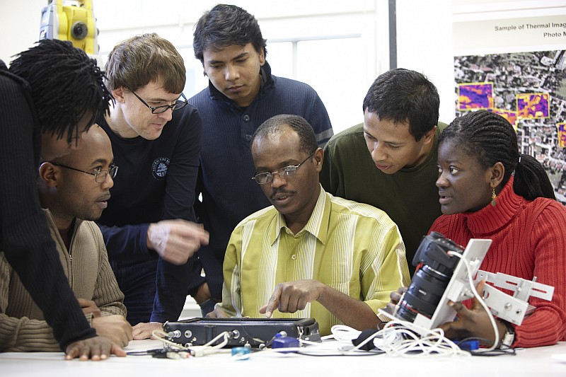
Motivation
International exposure
Students from "developing countries"
Source: Prof. Dr. Dietrich Schröder, M.Sc. Programme, Photogrammetry and Geoinformatics, 2.10.2013

Slide 5
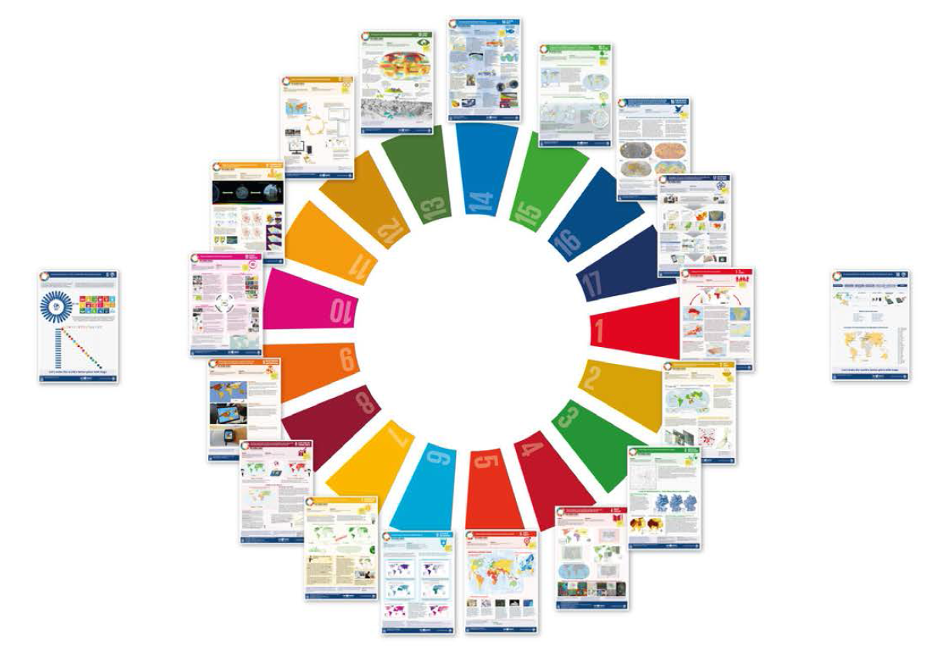
ICA’s mapping-centered perspective on the sustainable development goals
http://icaci.org/maps-and-sustainable-development-goals/ [2017-10-04]

Slide 6
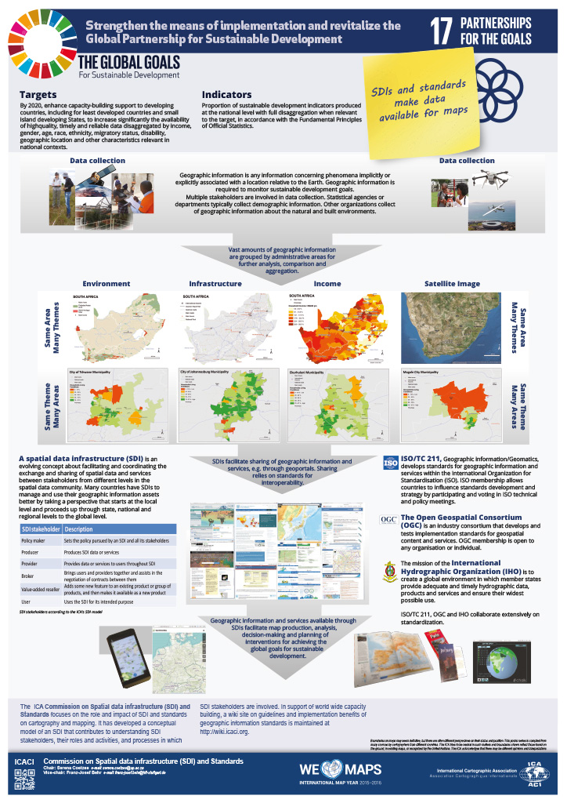
Motivation: ICA’s mapping-centered perspective on the sustainable development goals
http://icaci.org/maps-and-sustainable-development-goals/ [2017-10-04]

Slide 7
Some definitions

Slide 8
Some definitions
Data science:
  "a set of fundamental principles that support and guide the principled extraction of information and knowledge from data." [1]
  “The science of dealing with data, once they have been established, while the relation of the data to what they represent is delegated to other fields and sciences.” [2]
Data mining: The actual extraction of knowledge from data via technologies that incorporate these principles. [1]
Data-Driven Science:
  An empirical research method that is aimed to reason about huge data amounts [3]
  “an interdisciplinary field about scientific methods, processes, and systems to extract knowledge or insights from data in various forms, either structured or unstructured” [4]
[1] Foster Provost and Tom Fawcett: DATA SCIENCE AND ITS RELATIONSHIP TO BIG DATA AND DATA-DRIVEN DECISION MAKING http://online.liebertpub.com/doi/pdfplus/10.1089/big.2013.1508 [2017-10-04]
[2] Peter Naur (1974): Concise Survey of Computer Methods. Studentlitteratur, Lund, Sweden, cited after http://www.naur.com/Conc.Surv.html [2017-10-05]
[3] https://www.igi-global.com/dictionary/data-driven-science/39435
[4] https://en.wikipedia.org/wiki/Data_science

Slide 9
Data-driven Science
Collection of scientific tools, processes and systems to extract meaningful information from the data
Science of understanding and analysing data to explore underlying patterns
Initially introduced by Peter Naur in 1974:
"DATA: A representation of facts or ideas in a formalised manner capable of being communicated or manipulated by some process. …
The data representation must be chosen with due regard to the transformation to be achieved. "
Peter Naur (1974): Concise Survey of Computer Methods, Studentlitteratur, Lund, Sweden, ISBN 91-44-07881-1, 397 pp., see http://www.naur.com/Conc.Surv.html

Slide 10
Ethymology
Data: refers to acquisition, transformation, storing and retrieval of vast volumes and varieties of information
Data-Driven: means that progress in an activity is derived by data
Science: refers to extract insights from the data by applying scientific methods
Notes:
A New Paradigm
Versatile in nature applicable to many domains
Dynamic and Interactive data presentation
Insights about the phenomenon
Converting data to knowledge

Slide 11
Basic project goal
To to attract attention for the urgent need of implementation of the SDGs in the public by
attractive,
convincing,
dynamic
infographics.

Slide 12
Some definitions regarding "Open"
Open Knowledge Foundation
Data-driven science - Peter Murray-Rust view
FAIR data principles

Slide 13
The "Open Definition" of the Open Knowledge Foundation [https://okfn.org/opendata/]
Availability and access: the data must be available as a whole and at no more than a reasonable reproduction cost, preferably by downloading over the internet. The data must also be available in a convenient and modifiable form.
Reuse and redistribution: the data must be provided under terms that permit reuse and redistribution including the intermixing with other datasets. The data must be machine-readable.
Universal participation: everyone must be able to use, reuse and redistribute — there should be no discrimination against fields of endeavour or against persons or groups. For example, ‘non-commercial’ restrictions that would prevent ‘commercial’ use, or restrictions of use for certain purposes (e.g. only in education), are not allowed.

Slide 14
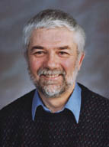
Data-driven science requires… [1]
Data must be in XML
Each discipline must create or re-use XML vocabularies ((hypertext (XHTML), math (MathML/OM), graphics (SVG), data, numbers, units, etc. (CML/STMML)) and domain-specific (GML (geoscience), CML (chemistry)
Domain metadata is provided through community ontologies
XML-aware software
Repositories
Metadata and Discovery
Quality and validation
Source: http://www-pmr.ch.cam.ac.uk/wiki/Peter_Murray-Rust [2017-10-05]
Peter Murray-Rust, Open access and open data activist, University of Cambridge
[1] Peter Murray-Rust (n.d.): Data-driven science - a scientist's view. http://www.ibrarian.net/-navon/paper/-Data_driven_science___a_scientist_s_view.pdf?paperid=9300672 [2017-10-05]

Slide 15
FAIR data principles (I)
To be Findable:
F1. (meta)data are assigned a globally unique and eternally persistent identifier.
F2. data are described with rich metadata.
F3. (meta)data are registered or indexed in a searchable resource.
F4. metadata specify the data identifier.
To be Accessible:
A1 (meta)data are retrievable by their identifier using a standardized communications protocol.
A1.1 the protocol is open, free, and universally implementable.
A1.2 the protocol allows for an authentication and authorization procedure, where necessary.
A2 metadata are accessible, even when the data are no longer available.
https://www.force11.org/group/fairgroup/fairprinciples [2017-10-03]

Slide 16
FAIR data principles (II)
To be Interoperable:
I1. (meta)data use a formal, accessible, shared, and broadly applicable language for knowledge representation.
I2. (meta)data use vocabularies that follow FAIR principles.
I3. (meta)data include qualified references to other (meta)data.
To be Re-usable:
R1. meta(data) have a plurality of accurate and relevant attributes.
R1.1. (meta)data are released with a clear and accessible data usage license.
R1.2. (meta)data are associated with their provenance.
R1.3. (meta)data meet domain-relevant community standards.
https://www.force11.org/group/fairgroup/fairprinciples [2017-10-03]

Slide 17
Related approaches

Slide 18
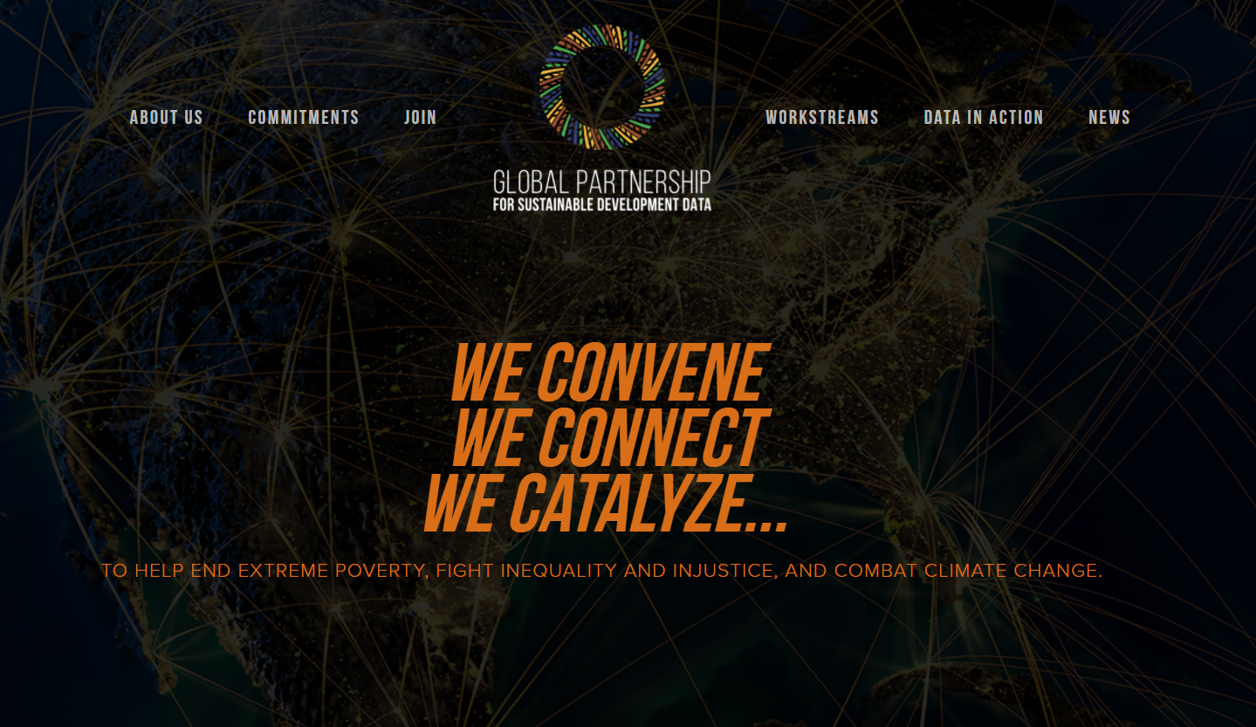
http://www.data4sdgs.org/

Slide 19
"The Global Partnership will enable the use of real-time, dynamic, disaggregated data to help achieve and monitor the SDGs, bridge data gaps and improve capacities to generate, share and use data."

Slide 20


http://www.data4sdgs.org/commitments
"We commit to build the BOP Design Center 65,000 Sq ft costing $10 million to be the coordination center and to influence the creation of many similar centers to collaborate together. We commit to host BOP World Convention each year as the trade event for face to face partnership. We invite you to join us this year 20-22 September in Singapore."

Slide 21


Barclays will champion the partnership from a cyber security agenda perspective, provide thought-leadership on defining and implementing a principles-based approach to global cyber resilience and security. Barclays will help develop global security norms and principles in the data-driven world.

Slide 22
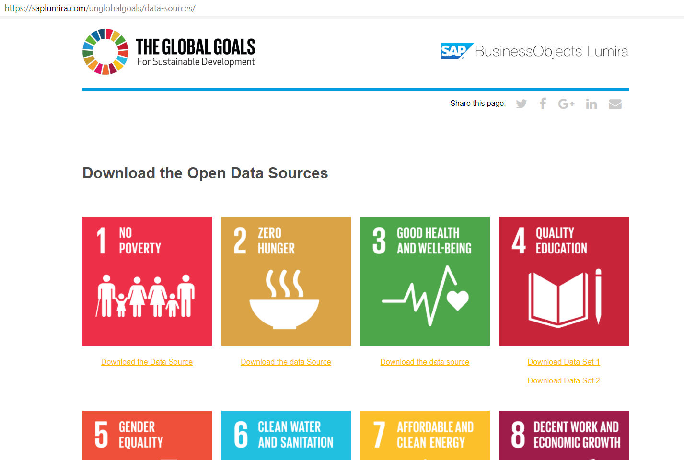

Slide 23
To summarize "Related approaches"
Delayed
Business driven

Slide 24
Getting indicator values

Slide 25
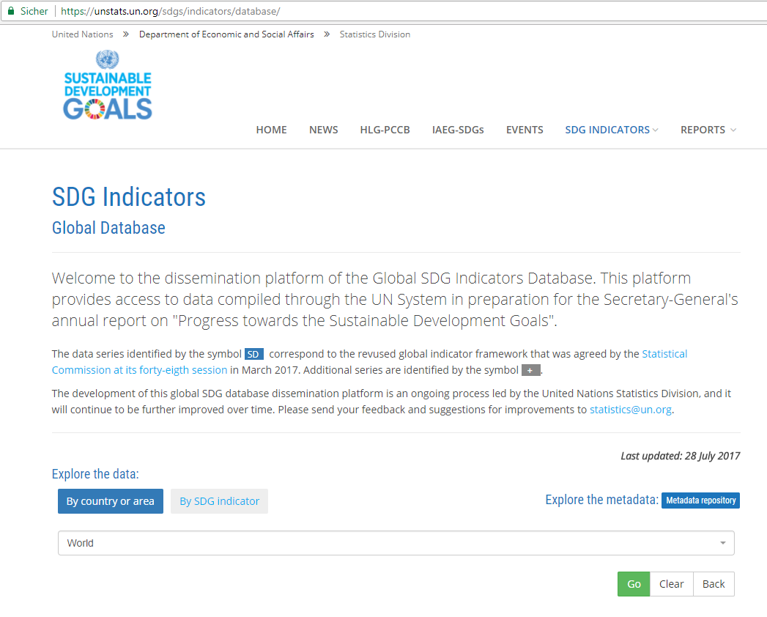
UN Statistics Division
https://unstats.un.org/sdgs/indicators/database/
Data
Metadata

Slide 26
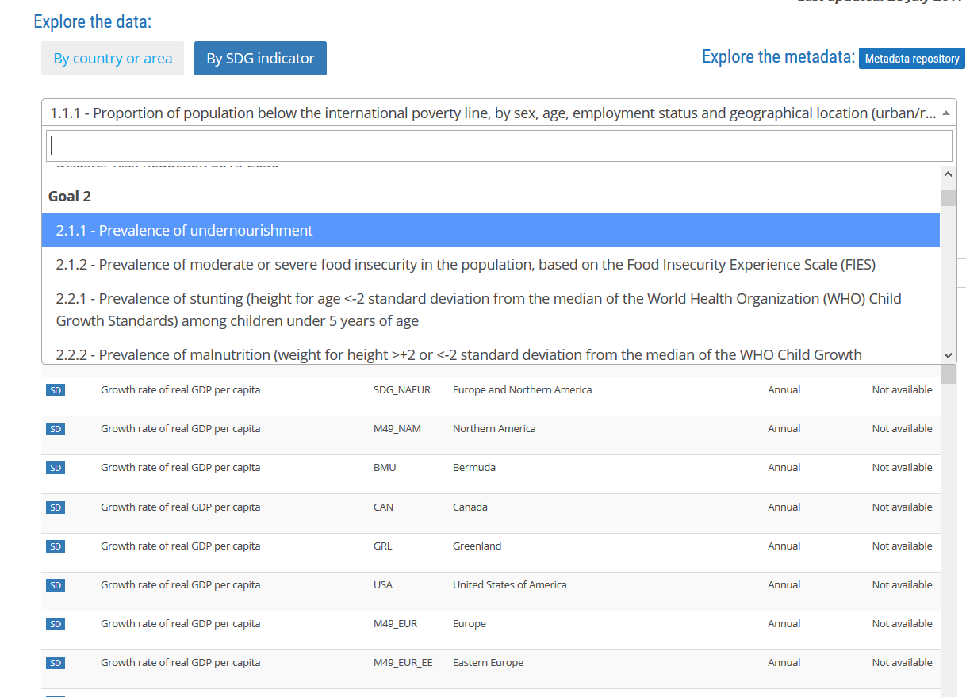

Slide 27
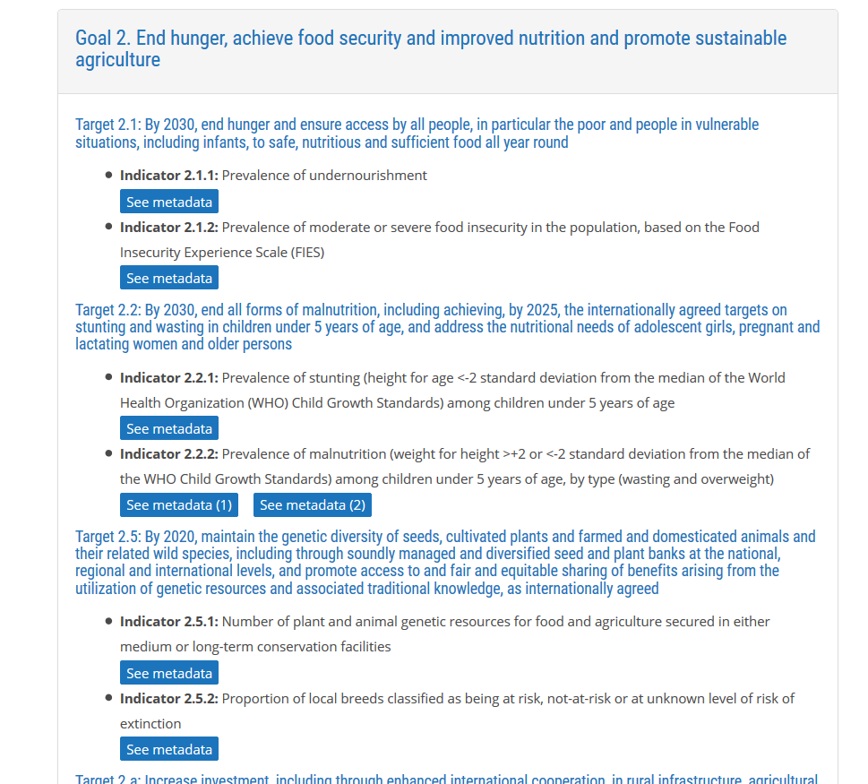

Slide 28
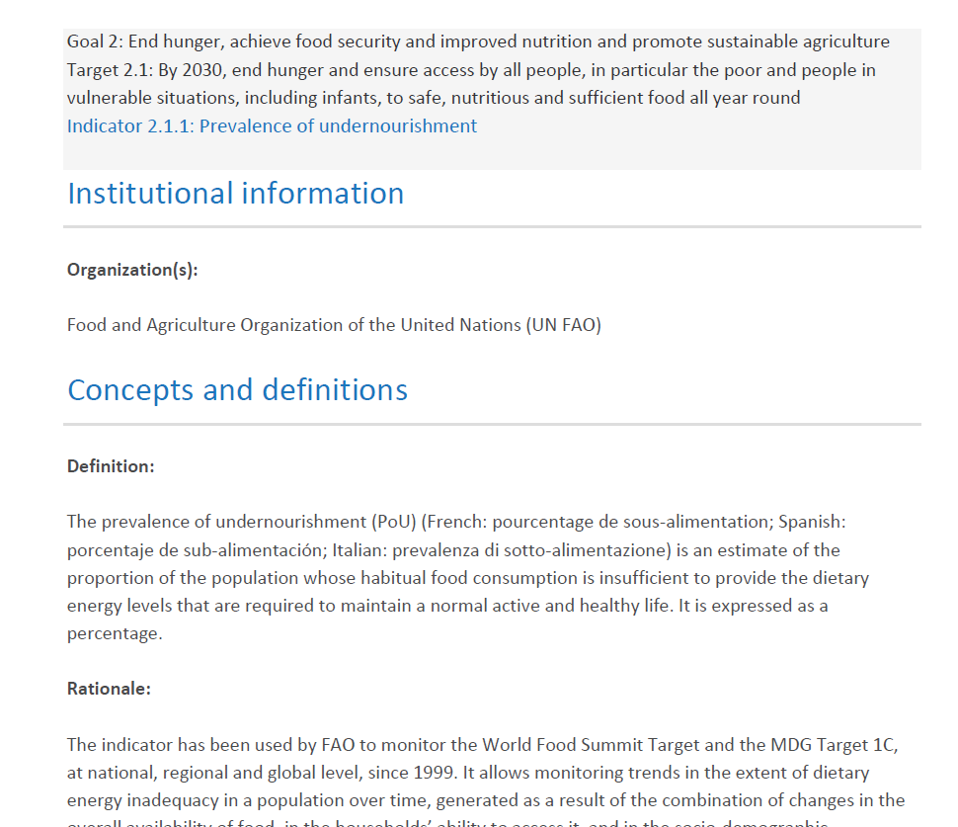

Slide 29
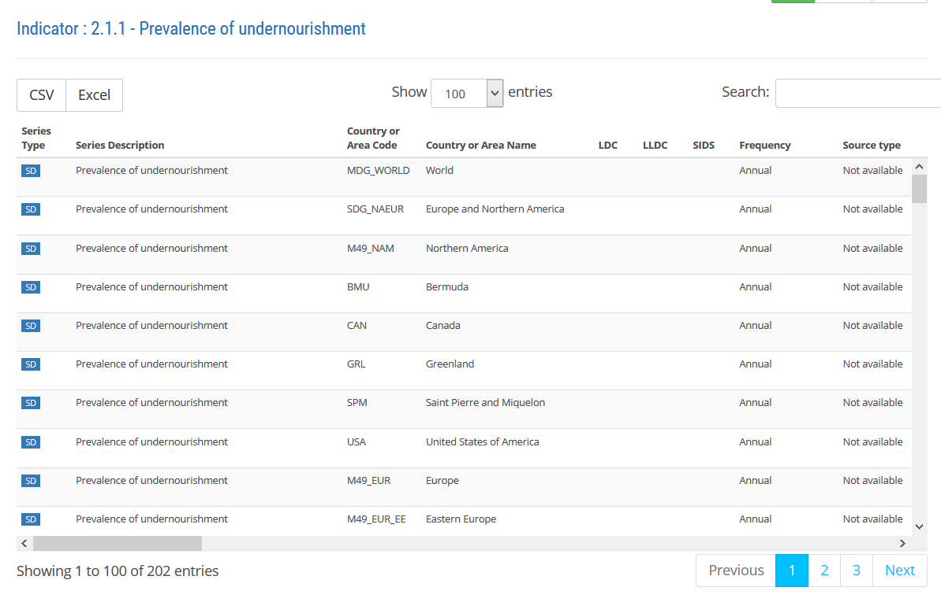

Slide 30
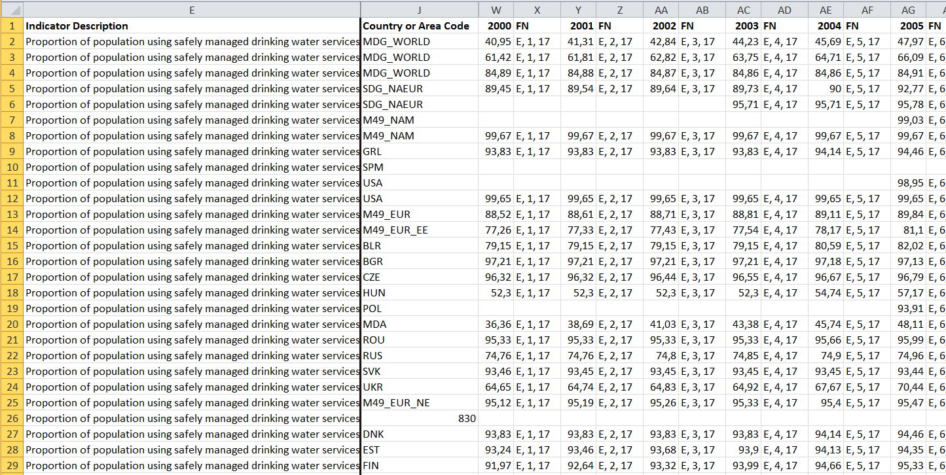
blob:https://unstats.un.org/037317cf-4e9b-428d-9f47-1320aefcd7e5

Slide 31
Evaluation
Data
  Open
  Standardized, well-known formats (XSL, CSV), but not XML-based
  Different time span, missing data, using of Blob URLs
Metadata
  PDF-format
  Not machine-readable, no standard format

Slide 32
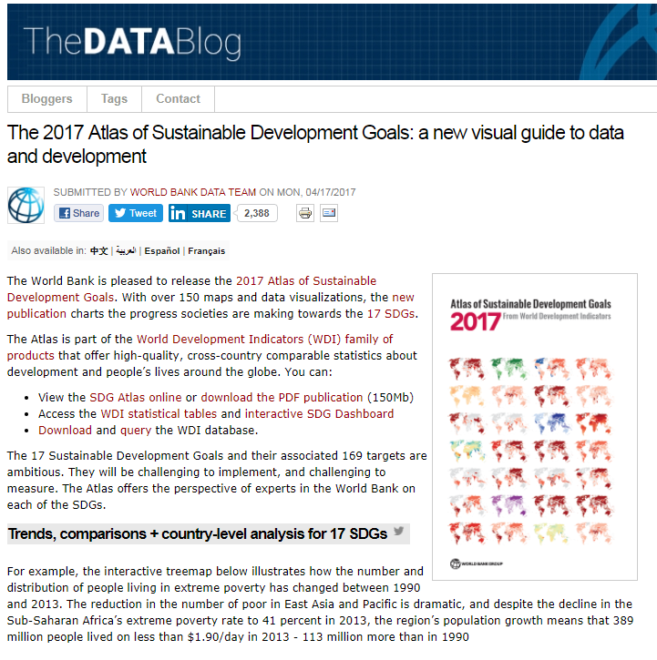
An alternative: World Bank
Maps, charts, and analysis data
http://blogs.worldbank.org/opendata/2017-atlas-sustainable-development-goals-new-visual-guide-data-and-development []2017-10-11

Slide 33
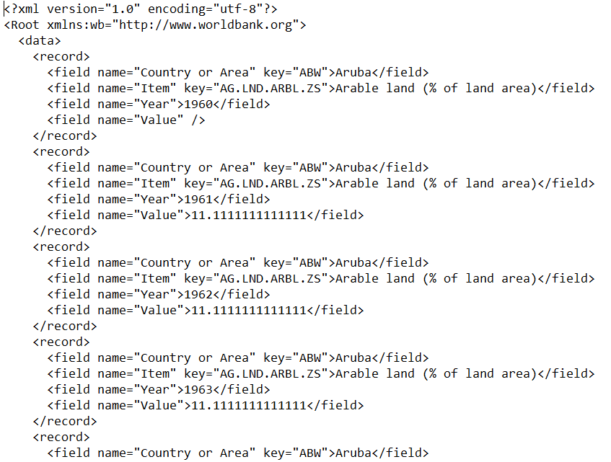
Accessing Word Bank's World Development Indicators
as PDF
Online tables
Country and Indicator pages
Bulk downloads from the data catalog (Excel | CSV)
Query and analyze data in databank
API (!)
as XML

Slide 34
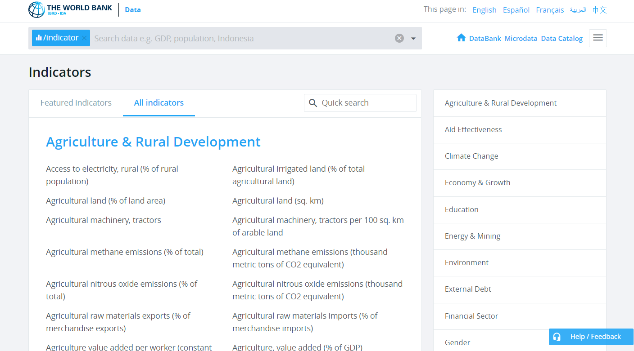
Some kind of alternative II
https://data.worldbank.org/indicator/?tab=all

Slide 35
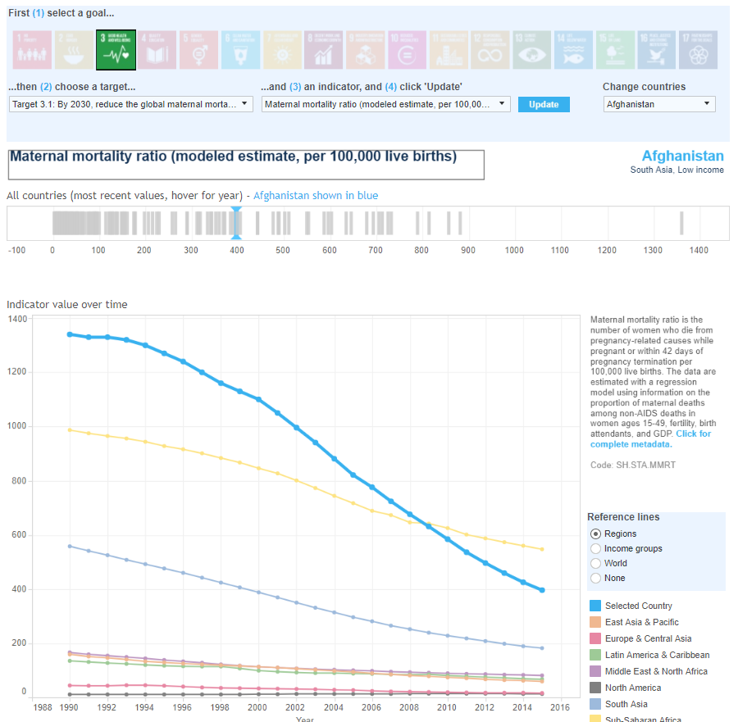

Slide 36
Visualization, underlying Architecture,
Principle of Data Driven Web Documents

Slide 37
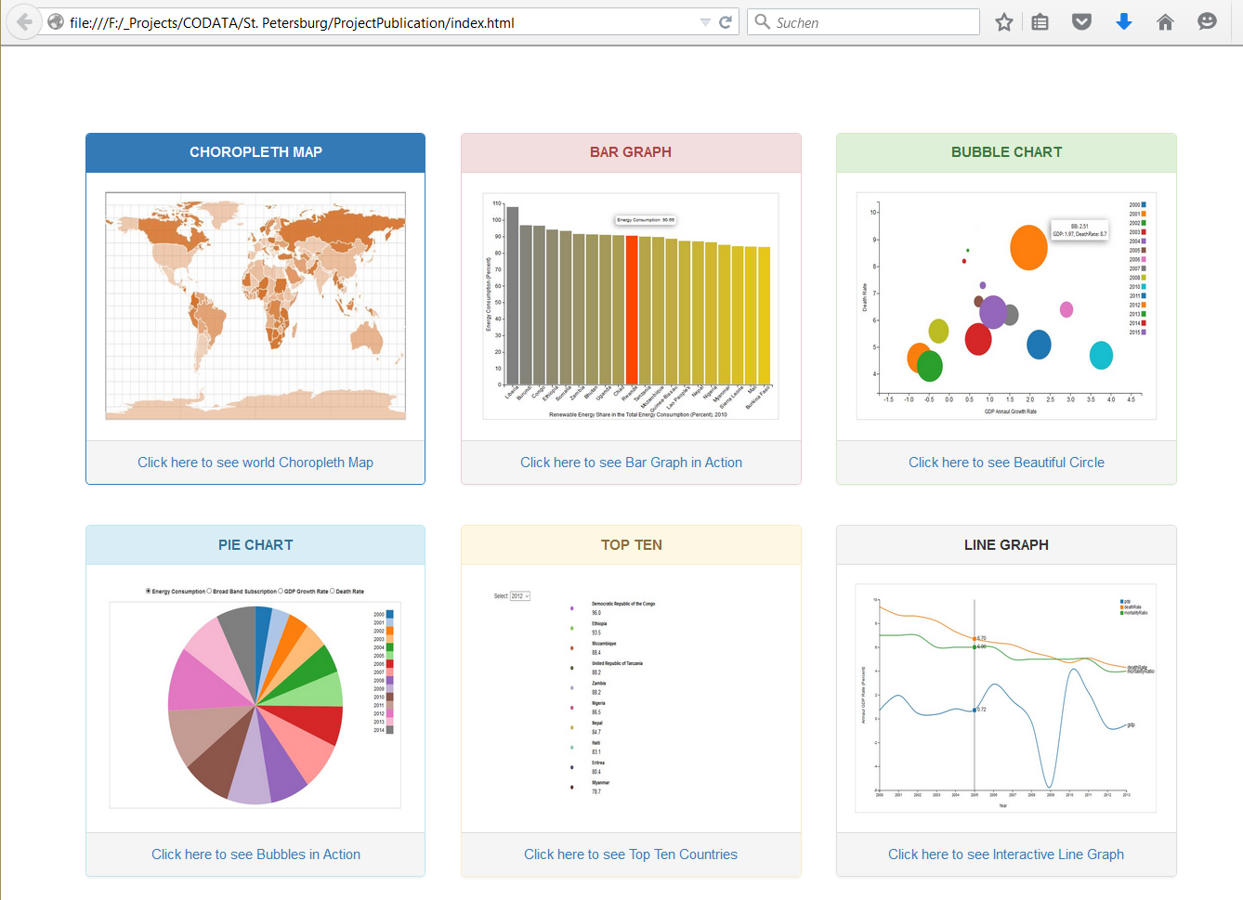

Slide 38
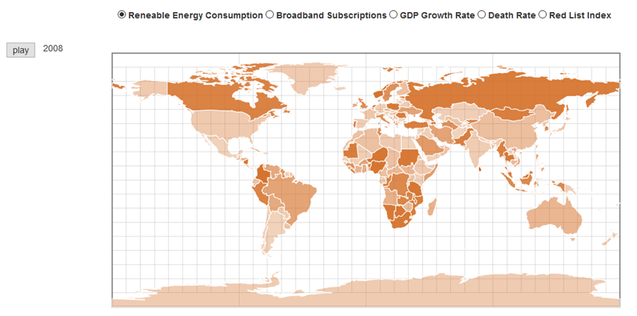
Choropleth Map

Slide 39
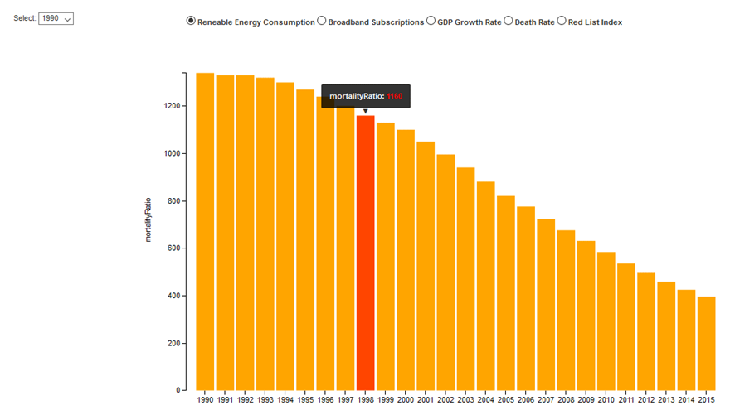
Interactive Bar Graph with Tooltip

Slide 40
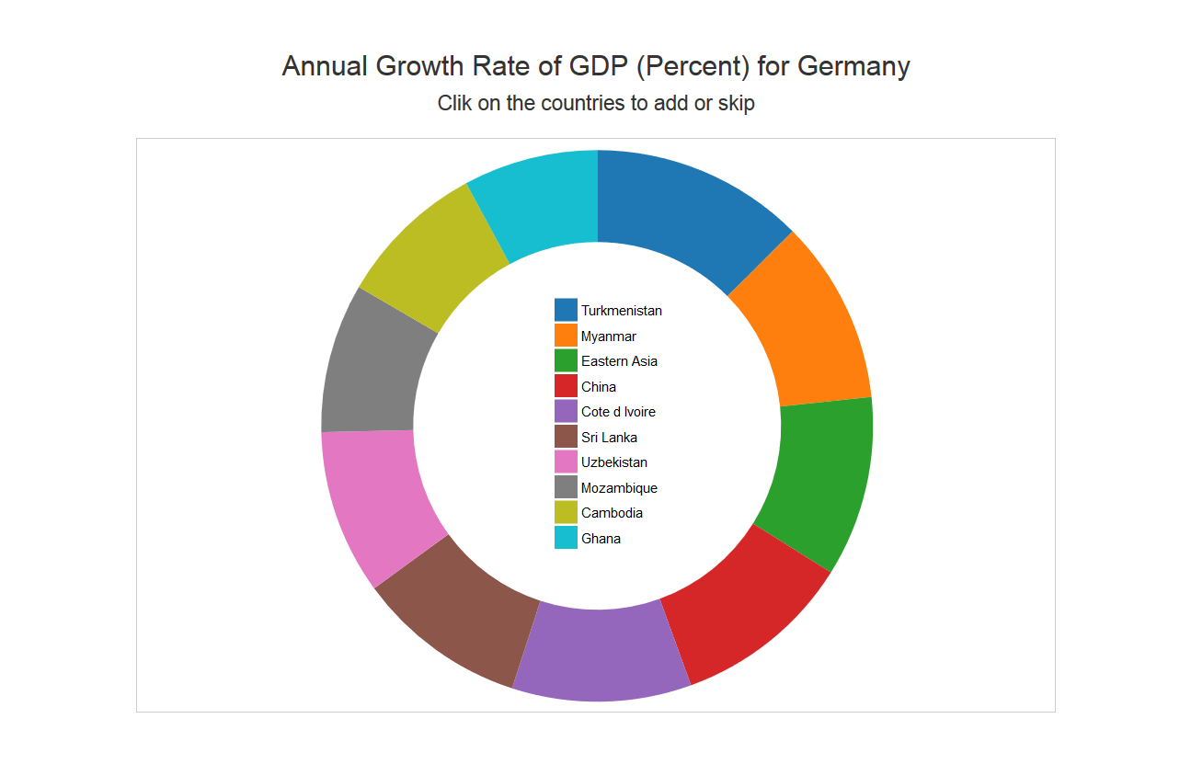
Selectable Donut Chart

Slide 41
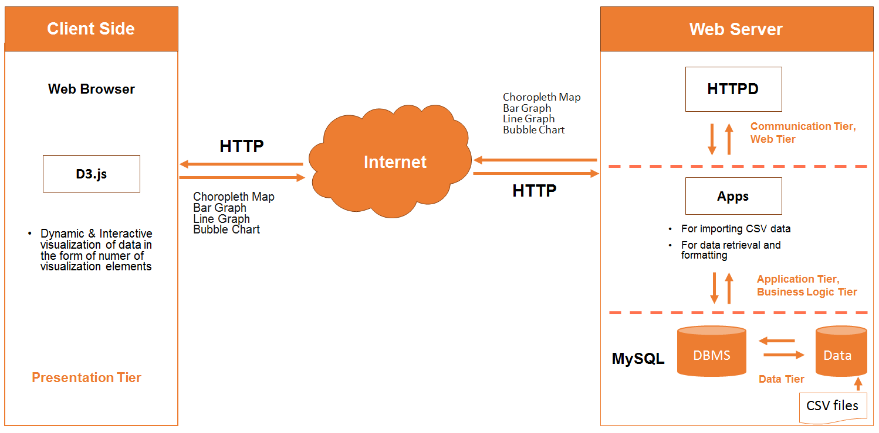
Architecture
CSV files

Slide 42
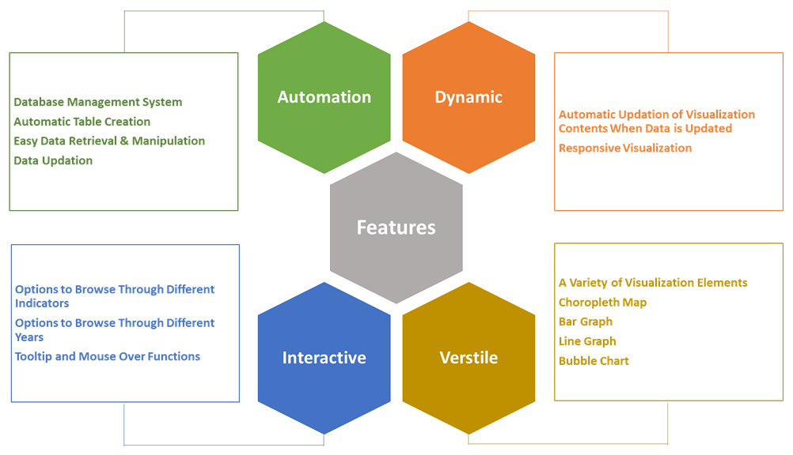

Slide 43
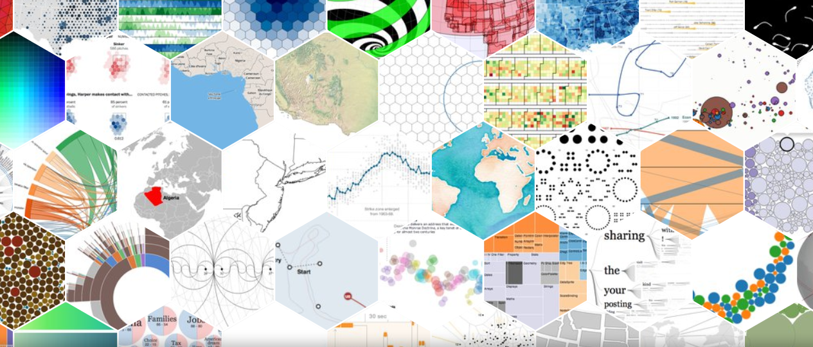
Data driven document – D3
innovative technology, plays a major role in web-based presentation of information
a JavaScript library for manipulating documents based on data.
https://d3js.org/

Slide 44
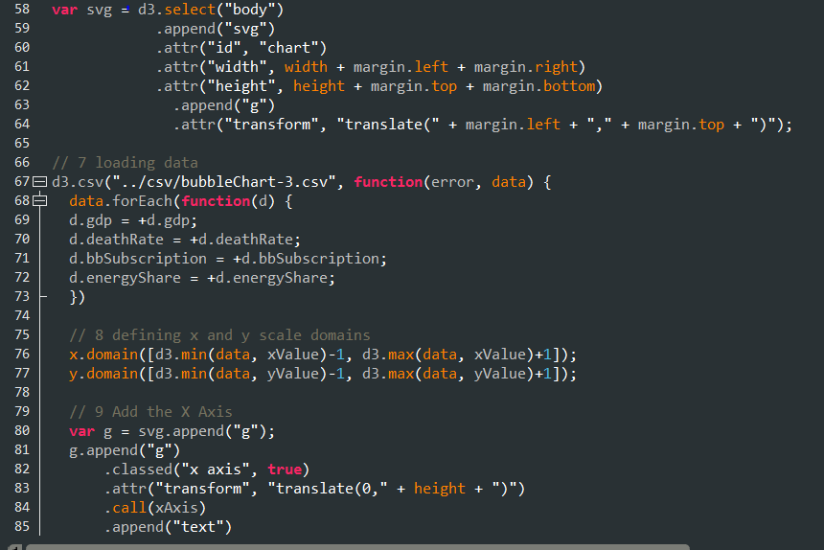
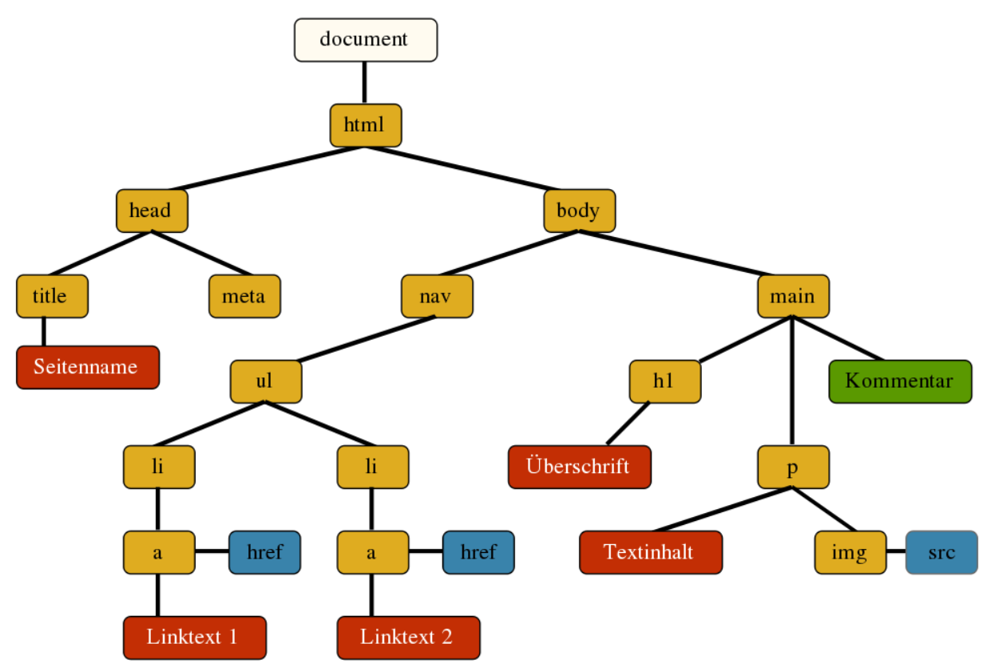
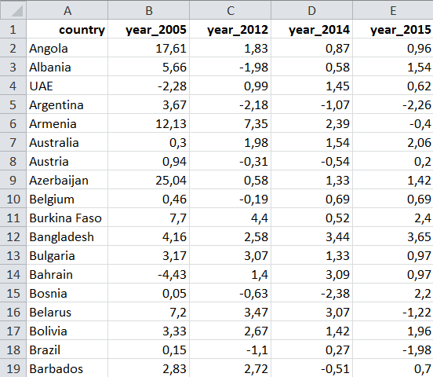
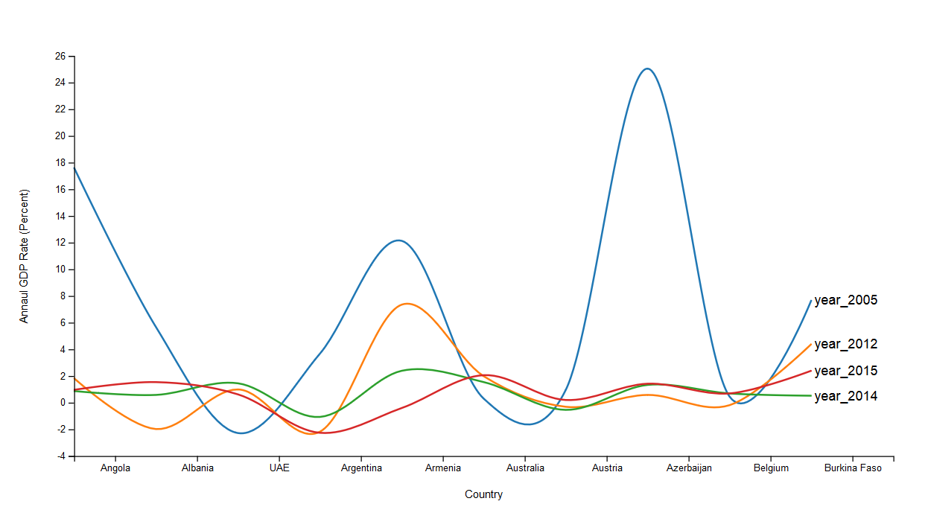
Document, based on D3: dat driven documents
Document Object Model
Visualization
Data

Slide 45
Document Object Model:
dynamically modified
Visualization

Slide 46
Visualization:
The final output

Slide 47
Essential outcome
Indicators are a must to measure progress towards the implementation of the SDGs at global, regional, national or thematic level.
The data are open, but proliferation is still incomplete.
Data access is insufficient. Standardized formats and APIs are needed.
Much work has to be done to make SDGs and their progress publicly recognizable.
We have to talk to the eyes to convince.
D3js can be a well-suited JavaScript library für visualization.

Slide 48
Prof. Dr. Franz-Josef Behr
Stuttgart University of Applied Sciences
ICA Commission on Standards and Spatial Data Infrastructrure franz-josef.behr@hft-stuttgart.de

Slide 49
Credits
Michael Bostock, Vadim Ogievetsky, and Jeffrey Heer (2011): D3: Data-Driven Documents. IEEE TRANSACTIONS ON VISUALIZATION AND COMPUTER GRAPHICS, VOL. 17, NO. 12, DECEMBER 2011
Peter Murray-Rust: Data-driven science - a scientist's view. http://www.ibrarian.net/navon/paper/Data_driven_science___a_scientist_s_view.pdf?paperid=9300672
Berlin Declaration on Open Access to Knowledge in the Sciences and Humanities. https://openaccess.mpg.de/Berlin-Declaration [2017-10-05]
UWE JOCHUM: URHEBER OHNE RECHT - Wie Staat und Bürokratie mittels Open Access Wissenschaftler enteignen. Lettre International 087, Winter 2009, http://www.lettre.de/content/uwe-jochum_urheber-ohne-recht
https://en.wikipedia.org/wiki/Data_science
www.pieria.co.uk/articles/data_science_from_half-baked_ideas_to_data-driven_insights
http://iopscience.iop.org/article/10.1088/1742-6596/699/1/012001/pdf
https://er.educause.edu/articles/2009/7/datadriven-science-a-new-paradigm
http://www.ncbi.nlm.nih.gov/pubmed/28154048
http://theconversation.com/why-data-driven-science-is-more-than-just-a-buzzword-76949
https://cs.lbl.gov/what-we-do/data-driven-science/

